Slide 1

Tuần 5
Change Data Capture
TS. Phạm Tuấn
ptuan@ute.udn.vn

Slide 2
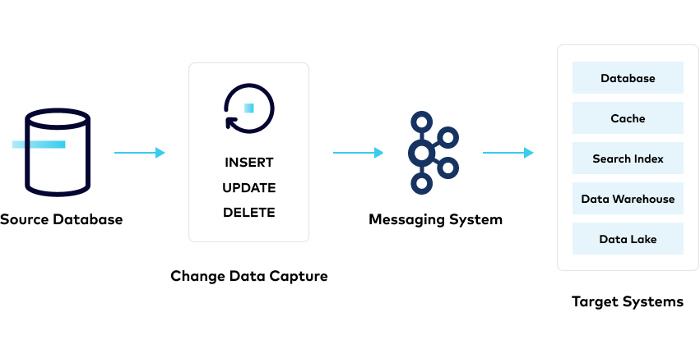
What is CDC ?
Change Data Capture (CDC) is a process that captures changes made to data in a database and ensures that these changes are reflected in other systems in real time. It's used to track and manage changes in a database.

Slide 3
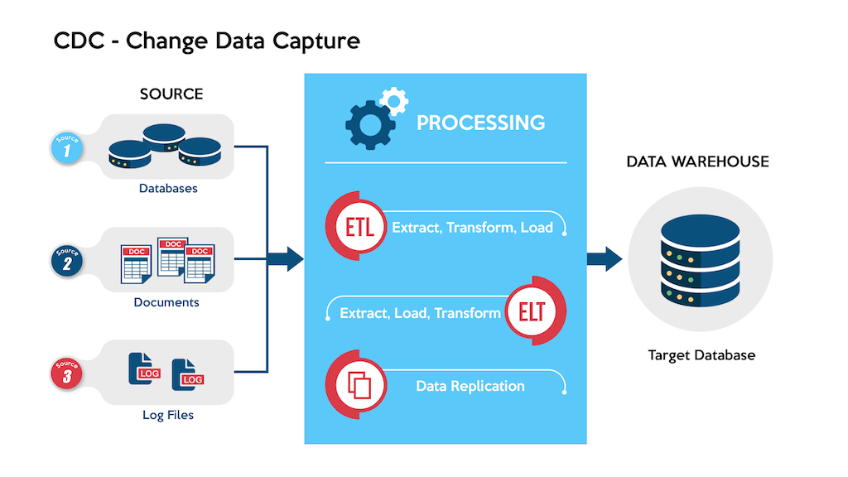
Why CDC ?
Eliminates Bulk Load Updates: supports incremental data loading or real-time streaming.
Log-Based Efficiency: captures changes from transaction logs, reducing system resource usage.
Zero-Downtime Migrations: real-time data movement, zero-downtime database migrations.
Synchronization Across Systems: keeps data synchronized across systems, supporting time-sensitive decisions.
Optimized for Cloud & Streaming: efficiently transfers data across networks, ideal for cloud and stream processing with tools like Apache Kafka.

Slide 4
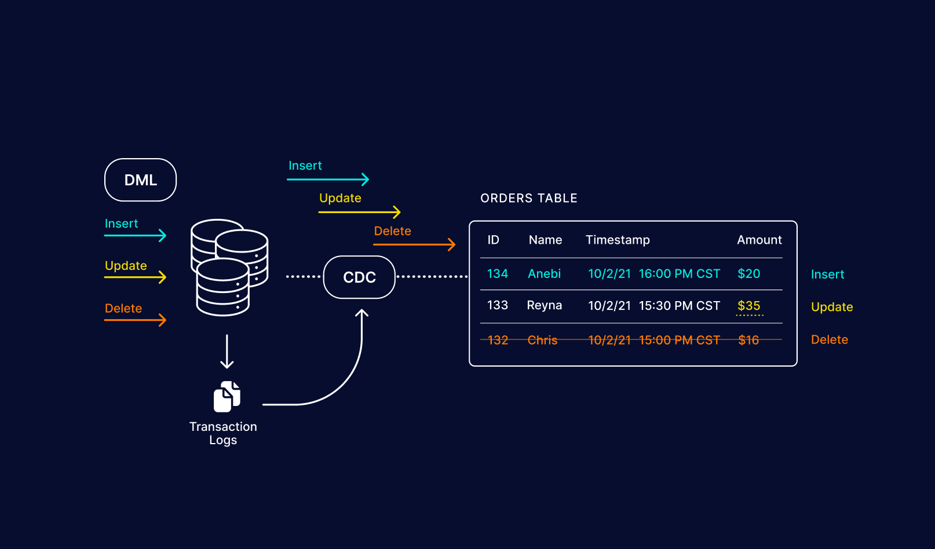
How Does Change Data Capture Work?
Data Changes in Source Databases: CDC tracks changes (INSERT, UPDATE, DELETE) in databases
Traditional Batch Processing: Syncs data in batch windows, causing delays and slowing down production databases.
Real-Time Syncing: CDC ensures immediate updates to target databases, eliminating delays from batch processing.
Push vs. Pull
Approach Selection: Choose between push and pull based on your use case.

Slide 5
Some common DB logs used for Change Data Capture (CDC)
MySQL: Binary Logs (Binlogs)
PostgreSQL: Write-Ahead Logs (WAL)
MongoDB: Oplog (Operation Log)
Oracle: Redo Logs
SQL Server: Transaction Logs
Cassandra: Commit Logs

Slide 6

Push vs. Pull
Push: The CDC system actively sends data changes to the target systems as soon as they occur.
Pull: The target system periodically queries the source system for changes and then processes them.
Notes:
Table

Slide 7

Patterns and Methods
Timestamp-based
Trigger-based
Log-based

Slide 8
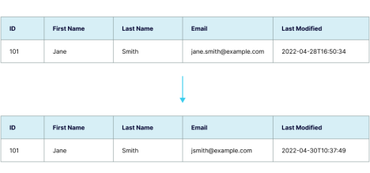
Timestamp-based
Pros:
Easy to use and implement.
Simple way to track changes over time.
Cons:
Cannot process DELETE operations, only soft deletes.
Adds computational overhead by scanning rows for updates.
Requires changes to the existing database schema.
Notes:
Downstream systems query the timestamp field to retrieve records updated since the last execution.

Slide 9
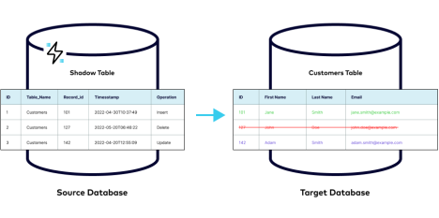
Trigger-based
Pros:
Captures all types of changes (INSERT, UPDATE, DELETE).
Widely supported by most databases.
Enables real-time data capture without polling.
Cons:
Can impact database performance due to multiple writes.
Requires schema changes.
Becomes complex with many triggers.
Notes:
Database triggers execute on events (INSERT, UPDATE, DELETE) to capture data changes. Changes are stored in a "shadow table" and can be published to messaging queues for target systems to subscribe to.

Slide 10
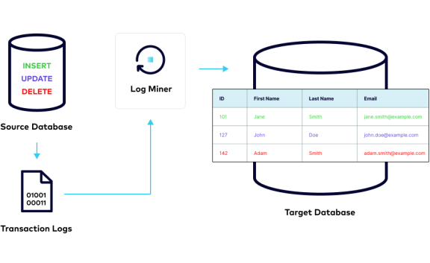
Log-based
Pros:
No computational overhead on source databases.
Captures all changes (INSERT, UPDATE, DELETE).
No need to alter source database schema.
Cons:
No standard format for transaction logs; varies by vendor.
Target systems must handle rolled-back changes.
Notes:
Transaction logs capture all changes (INSERT, UPDATE, DELETE) in real-time. Target systems read from these logs, minimizing the computational load on the source database.

Slide 11
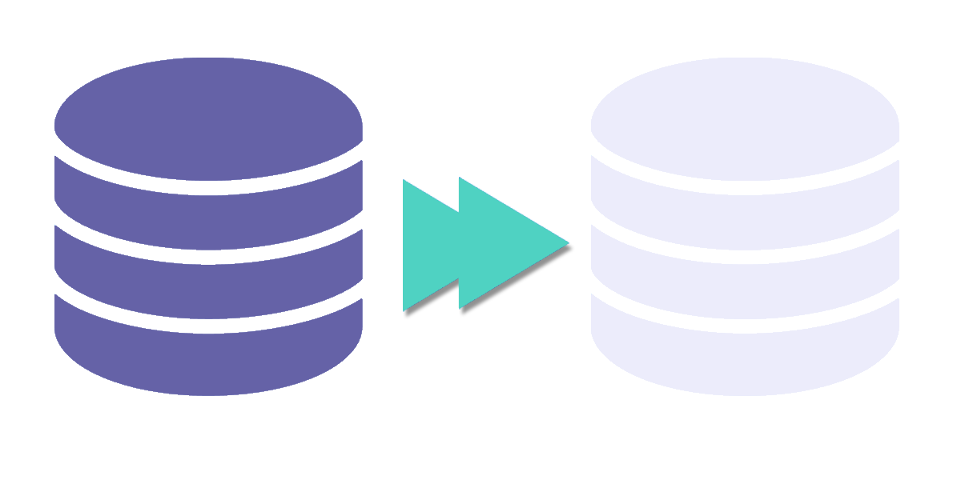
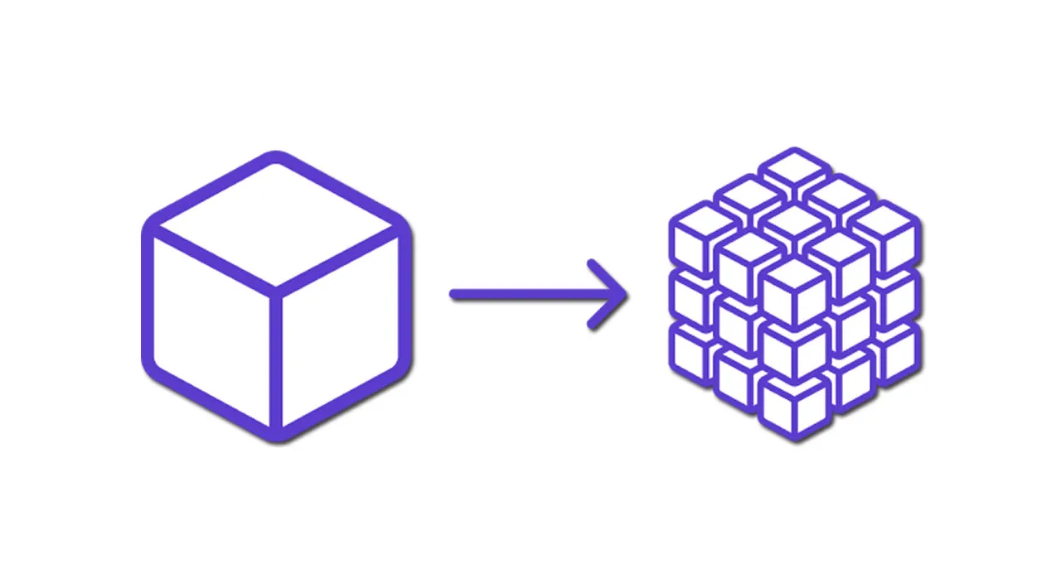
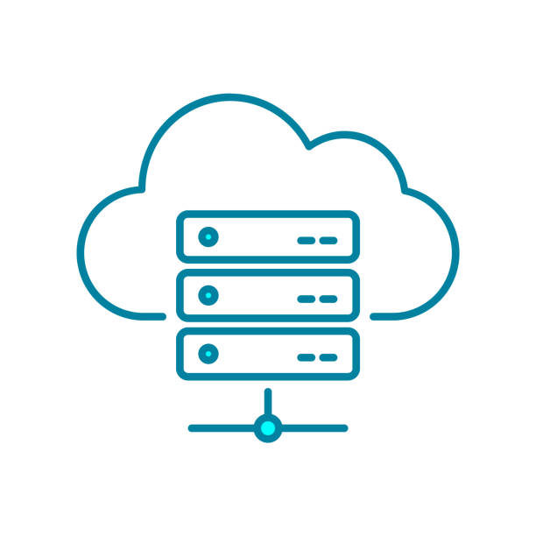
Use Cases
Continuous Data Replication: Ensures data consistency across multiple systems in real-time, useful for disaster recovery and cross-region deployments.
Integration with Microservices Architecture: CDC enables decoupled microservices to access consistent, up-to-date data without tightly coupling systems.
Cloud Adoption: Supports seamless migration of on-premise data to the cloud by capturing changes in real-time and ensuring minimal downtime during migration.

Slide 12
Exercise 2
A

Slide 13

Any questions ?

